Slide 1

2023
MOOC: Fundamentals of Digital Marketing
MOBILE MARKETING
Karmvir 41221075
Ritik Kumar 41221131
Sachin Rajbhar 41221139
Sachin Kumar Singh 41221138
Vikas 41221186
BCA Sem IV

Slide 2




INTRODUCTION
Marketing means the creation & promotion of online materials with the goal of increasing interest in a product or service.
Mobile marketing is any advertising activity that promotes products and services via mobile devices, such as tablets and smartphones. It makes use of features of modern mobile technology, including location services, to tailor marketing campaigns based on an individual's location.
They are to be integrated with - cameras often gps
& also share directions to your location
We can send messages even when they aren’t using them - Push Notifications
Also cover loyalty programs like to earn points, simple checkouts
The market we operate in is highly competitive, with numerous players vying for the attention of consumers.
Some Instant app builders: appify, buildfier, como

Slide 3
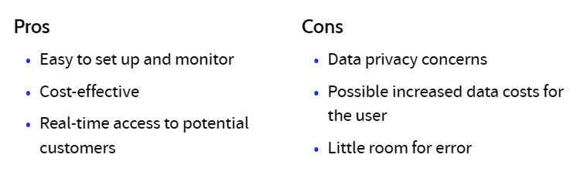




MARKET OVERVIEW
Marketing
The global mobile marketing market is expected to grow from USD 11.0 billion in 2020 to USD 57.9 billion by 2030, at a CAGR of 18.3%.
SMS marketing is the most widely used channel for mobile marketing, followed by mobile app marketing. Mobile web marketing and mobile video marketing are expected to be the fastest-growing channels during the forecast period.
Retail is the largest vertical in the mobile marketing market, followed by healthcare and telecom, due to the increasing use of mobile devices for shopping.
By region,North America is the largest market for mobile marketing, followed by Europe and Asia Pacific.

Slide 4
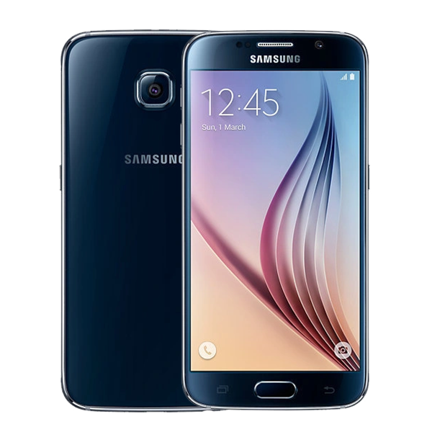

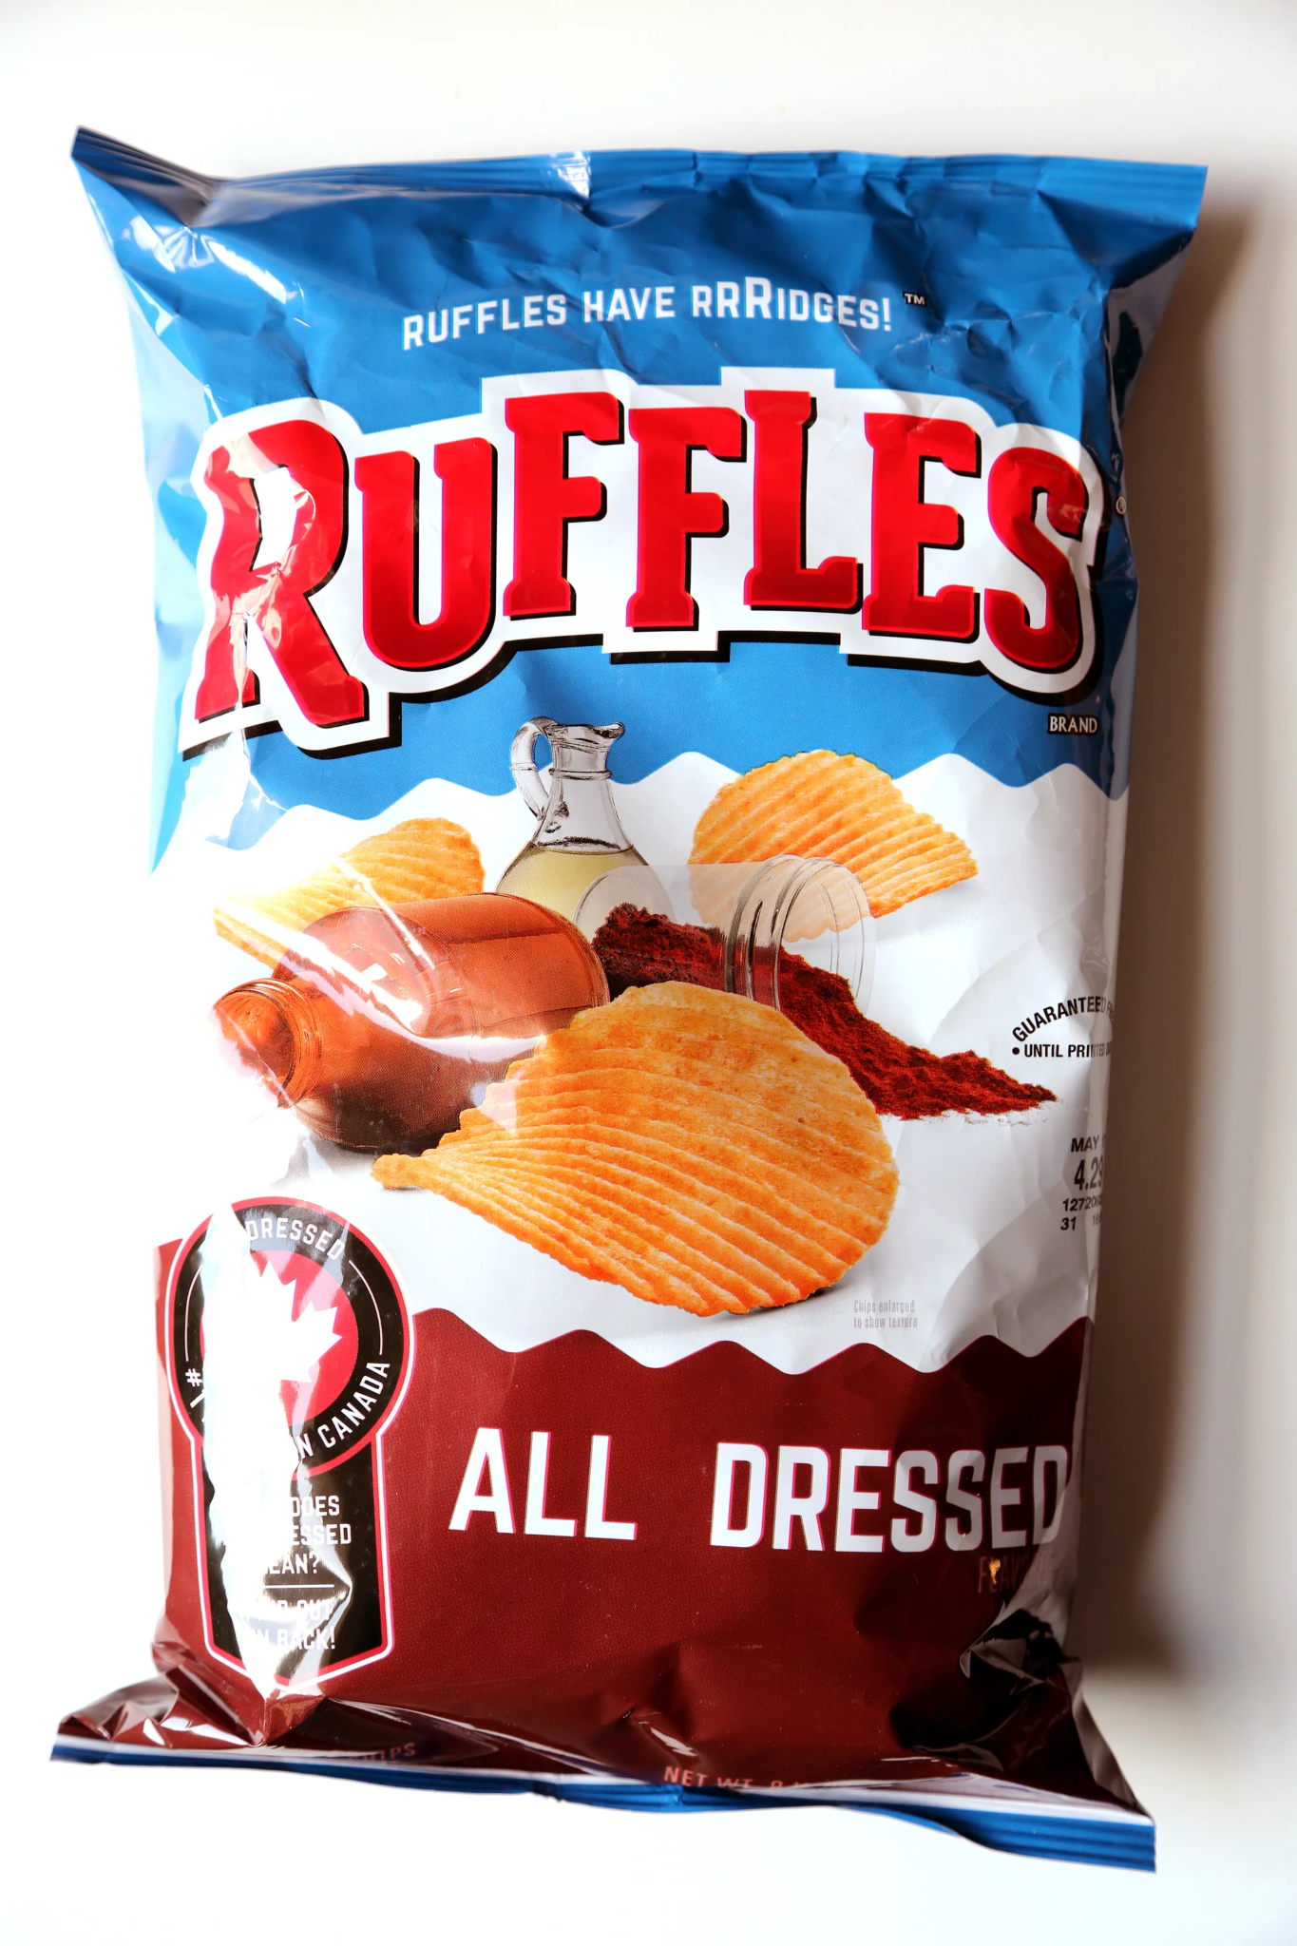
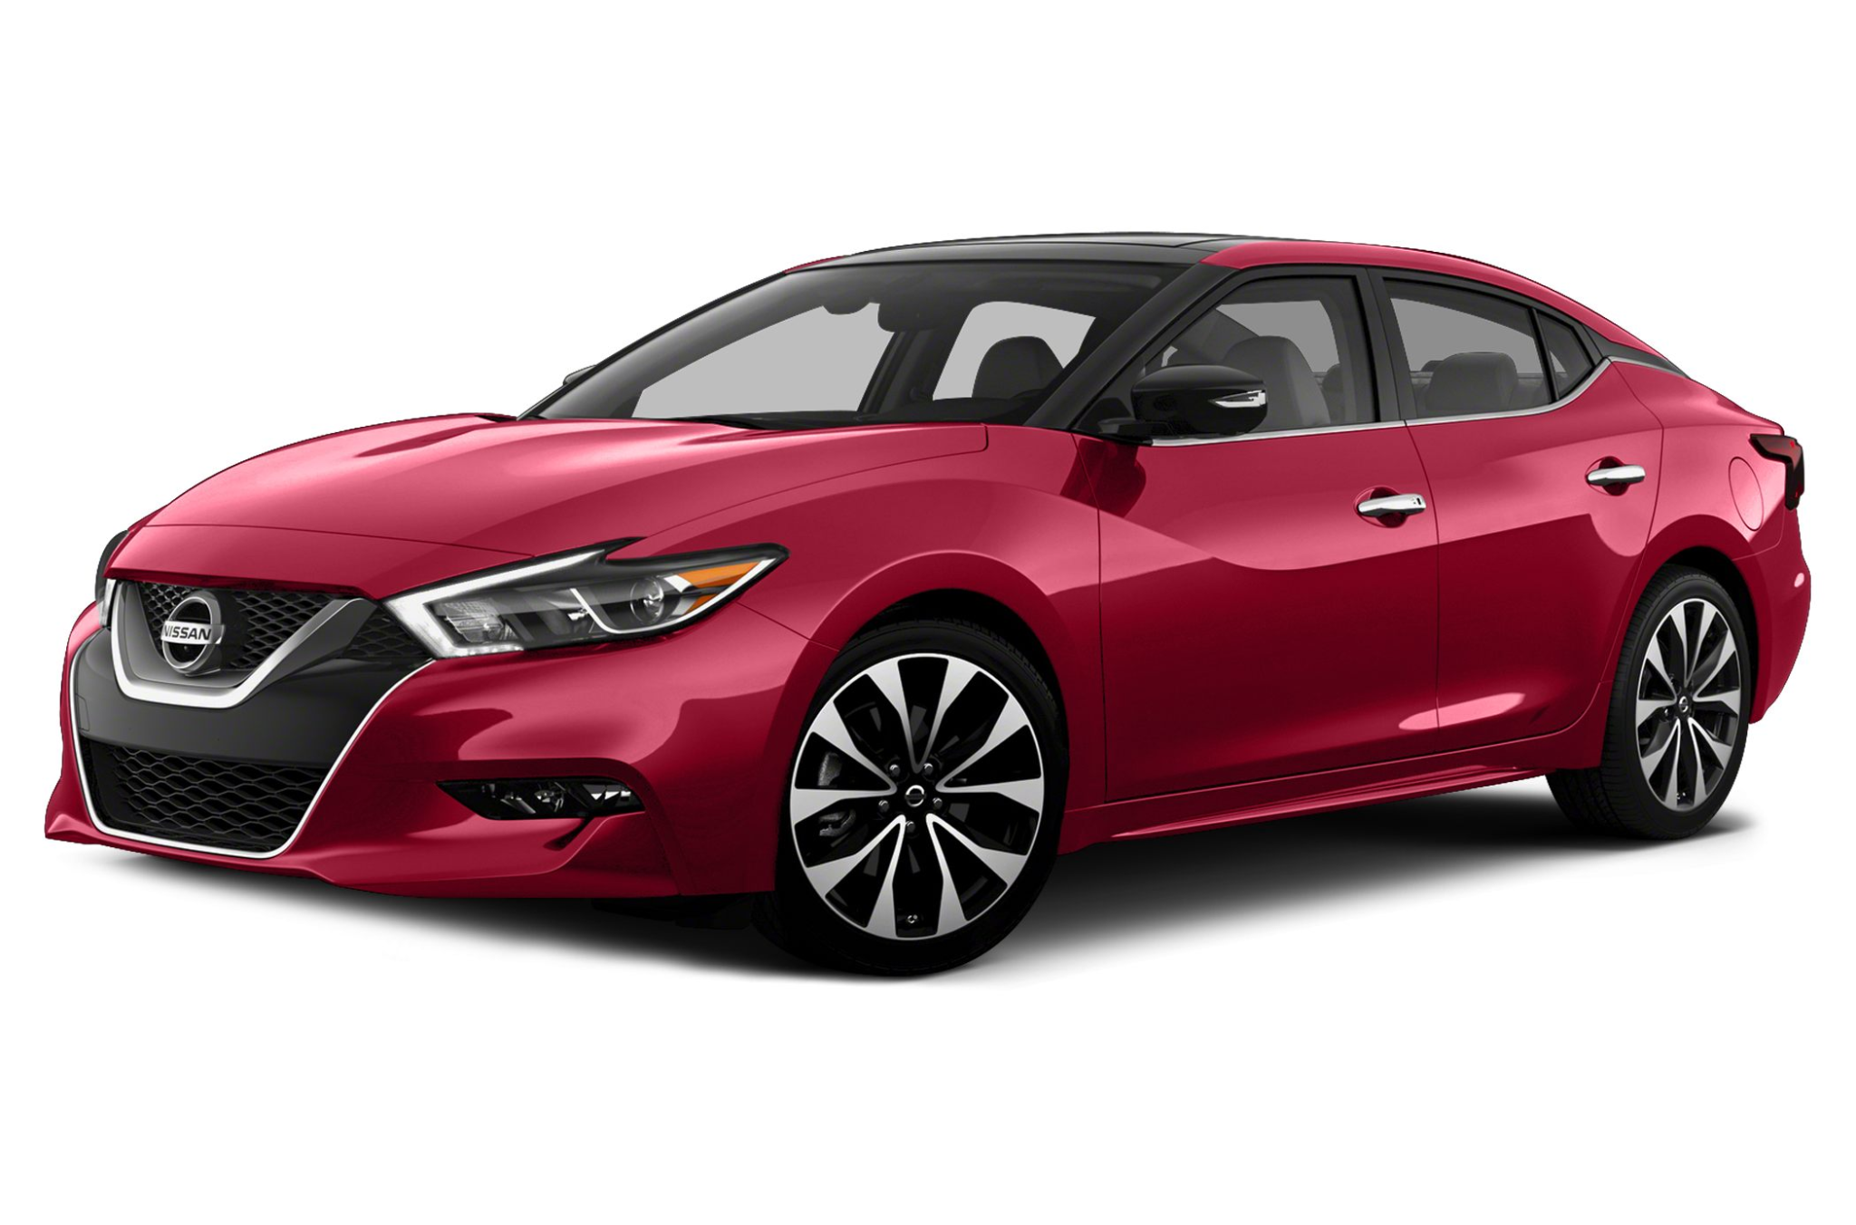
Examples of Mobile Marketing
Samsung
For the release of its Galaxy S6 phone, Samsung worked with Indian tech company InMobi to develop interactive ads. These ads created a personalized real-time battery identification mobile ad unit that displayed the product and service to a user with a demo on their phone when their battery levels were low. The mobile ad highlighted the new phone's "super fast charging capability" right when their battery was low, enticing them to upgrade to the new phone.
Pond's
Pond's is another company that partnered with InMobi. Pond's created an ad for one of their acne products that was interactive in that when a person looked at their phone, the camera would capture their features and highlight acne-prone areas. The ad didn't require any software to be downloaded or for the user to visit any other site.
Ruffles
Ruffles witnessed declining sales in Brazil and decided to target teenagers with interactive ads. It created a mobile reality game called AmiGo. The user saw what the game showed them while their friends saw what the user's camera showed them. Friends would see Ruffle chips surrounding the user and they could send voice commands to their friend on where they can grab the chips. The more chips collected the more points the user would receive. Ruffles ranked the highest-scoring users on its social media accounts.
Nissan
Nissan created the "Evil Snowmen" ad for its Rogue SUV. The ad was a video where its Rogue SUV fought a gang of snowmen. The ad also contained hotspots on the screen that users could touch to learn more about the SUV's features. Other hotspots also provided weather and snow safety advice.

Slide 5
How Do You Start a Mobile Marketing Business?
Set up a Mobile Website
People use their smartphones for almost everything these days and so it's important that your website is formatted correctly for viewing on a smartphone. If you have an existing website, many companies offer automated systems that convert your existing website for viewing on a mobile platform. WordPress and GoDaddy are two great examples of companies that do this.
Set up Your Business on Location-Based Platforms
Setting up your business on the various location-based platforms, such as Foursquare, Gowalla, and Facebook Places is a good way to make your business available to a wider range of people and to start running mobile ad campaigns.
Start a Mobile Ad Campaign
Once your website is set up for mobile device viewing and you've understood how the mobile ad marketing world works, it's time to set one up for your business. Mobil ad campaigns are a crucial element for businesses to get viewership. If you have a skateboard shop in the neighborhood and someone searches "best skateboard shops near me" you want to make sure that your business pops up in their search.
Utilize QR Codes
QR codes, which are square bar codes containing information, can be placed in a variety of locations, and once scanned by a phone's camera, direct a user to a website that can show a business's website, promotions, or other important information. They're a simple and easy way to make your business known.

Slide 6

CONCLUSION
In conclusion, this marketing report has identified key market trends and provided recommendations for our company to stay competitive in the market. By investing in, mobile marketing we believe that our company can increase sales and improve brand awareness.
“Successful Content doesn’t need to be viral or reach millions of people,
focus on designing your content so that it moves customer towards a specific goal”
Submitted To: Sh. Gurvinder Singh

